Slide 1
PGS Plots

Slide 2
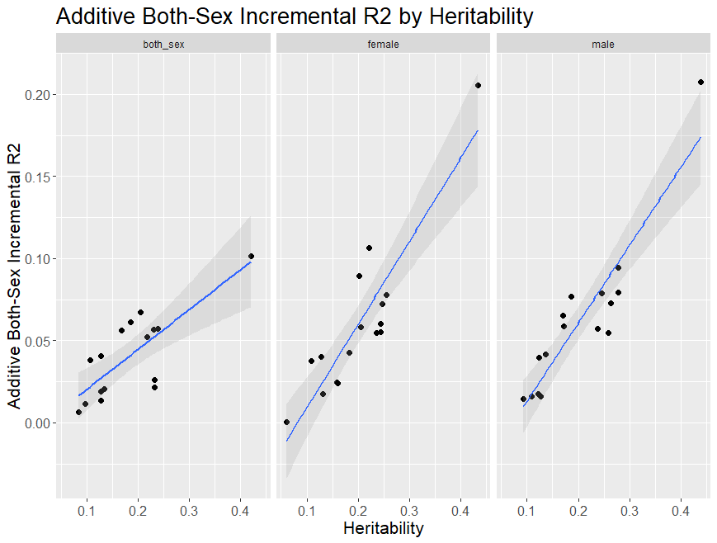
Additive both-sex model

Slide 3
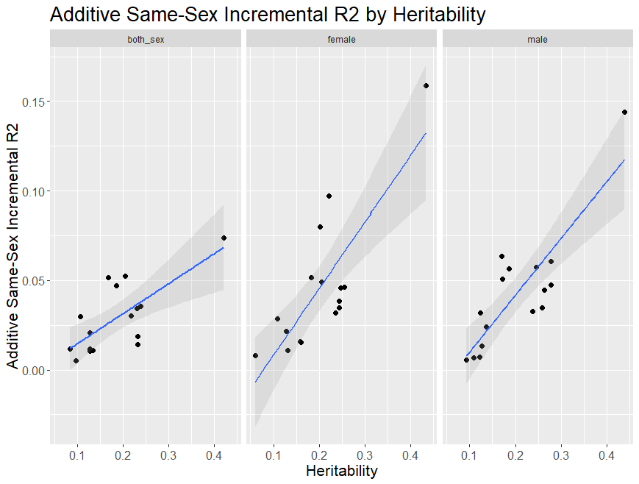
Additive sex-specific model

Slide 4
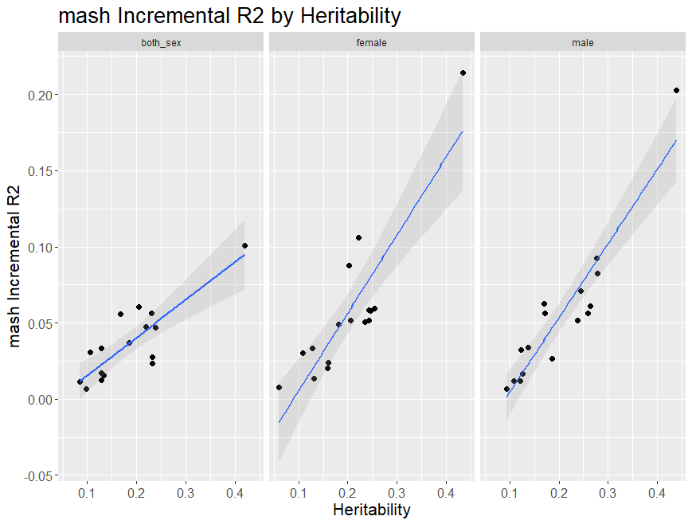
mash model

Slide 5
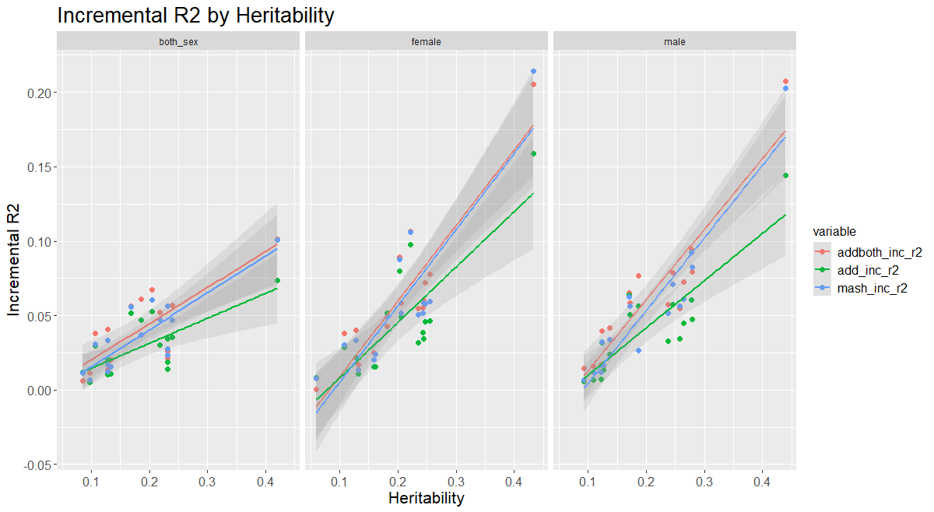
Separated by sex

Slide 6
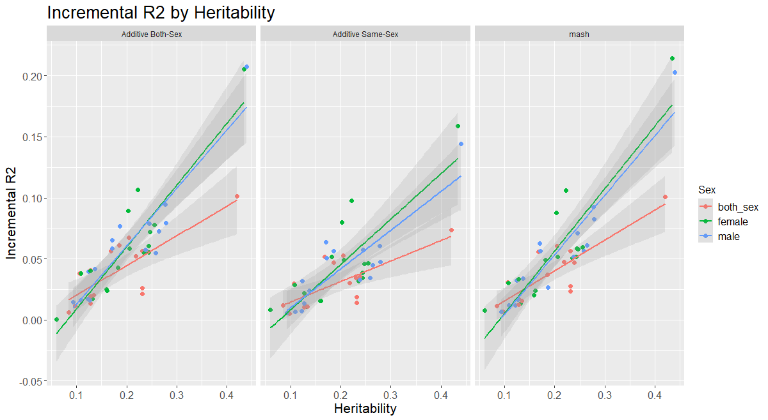
Separated by model

Slide 7
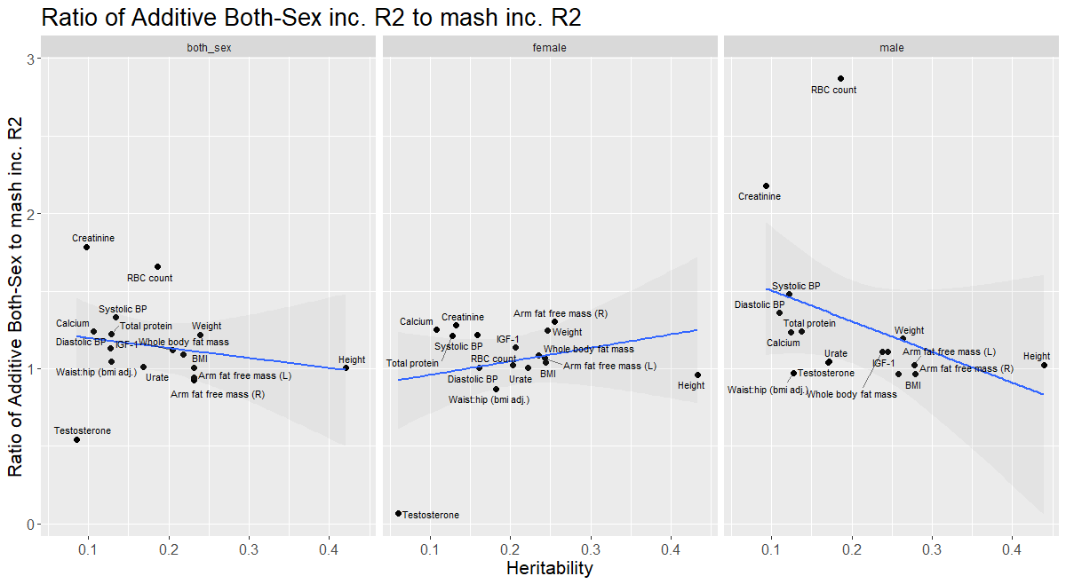

$$\frac{additive both sex model}{mash model}$$

Slide 8
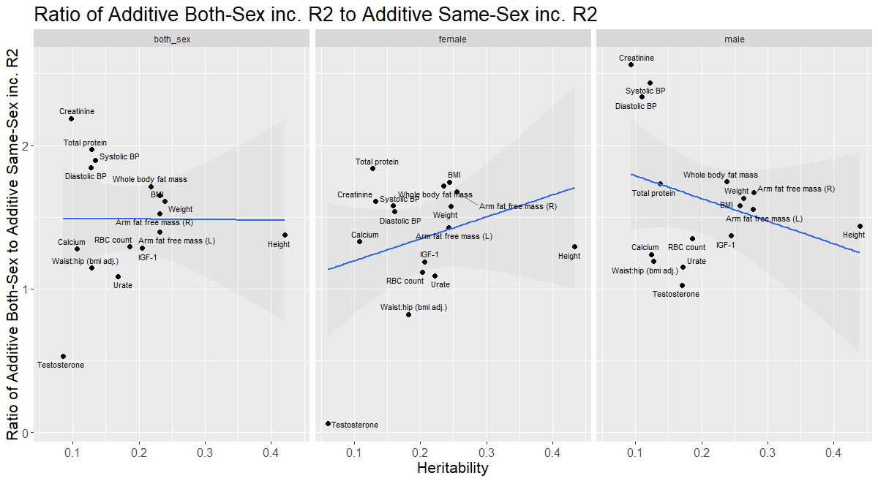

Slide 9
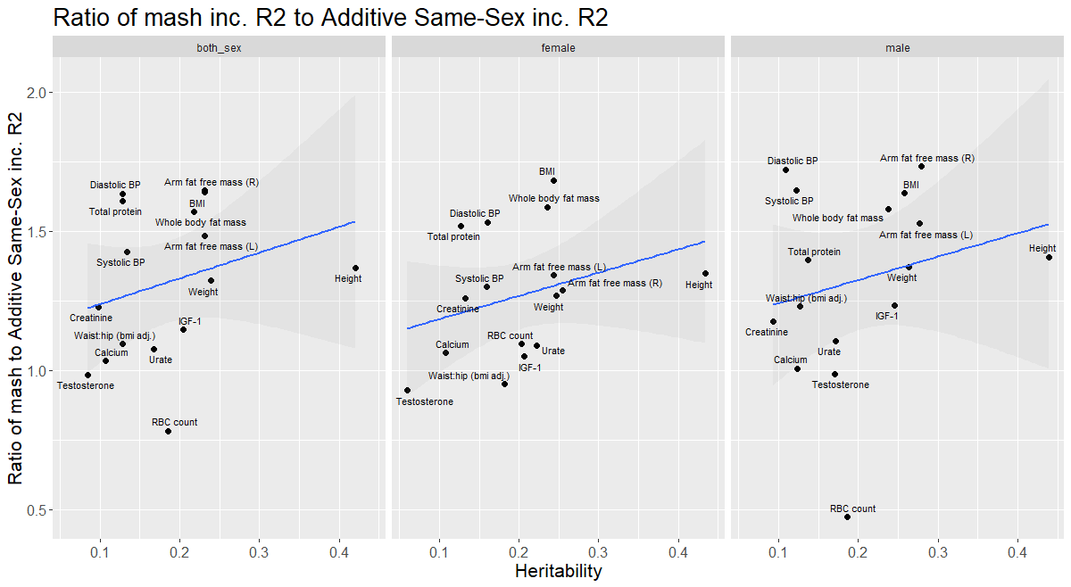

Slide 10
